Slide 1

Social Media
Campaign Manager
Presentated by Team CodeRed

Slide 2
Team
Pranav Shukla
Prit Kanadiya
BTech - CE
BTech - CE
Raghav Agarval
Vedant Nimje
BTech - IT
BTech - CE

Slide 3



Our Solutions
Audience Analysis
Trend Analysis
Content Generation

Slide 4
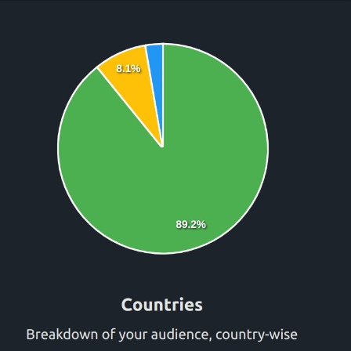
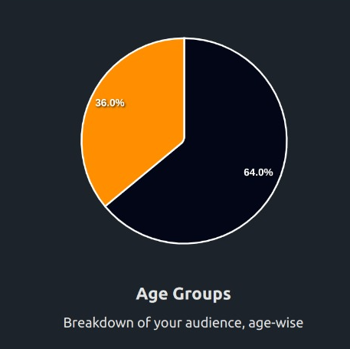
Audience analysis
Insights into the audience's demographics effortlessly. Our intuitive pie charts showcase follower distribution across different countries and age groups

Slide 5
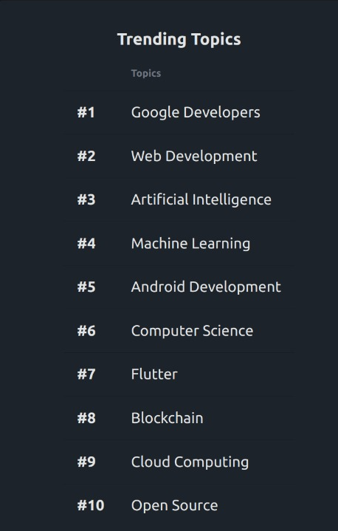
Trend Analysis
Discover the top trendy words associated with users followers, ensuring their content remains relevant and engaging
We also Identify the best time to post content, maximizing visibility and interaction with audience.

Slide 6
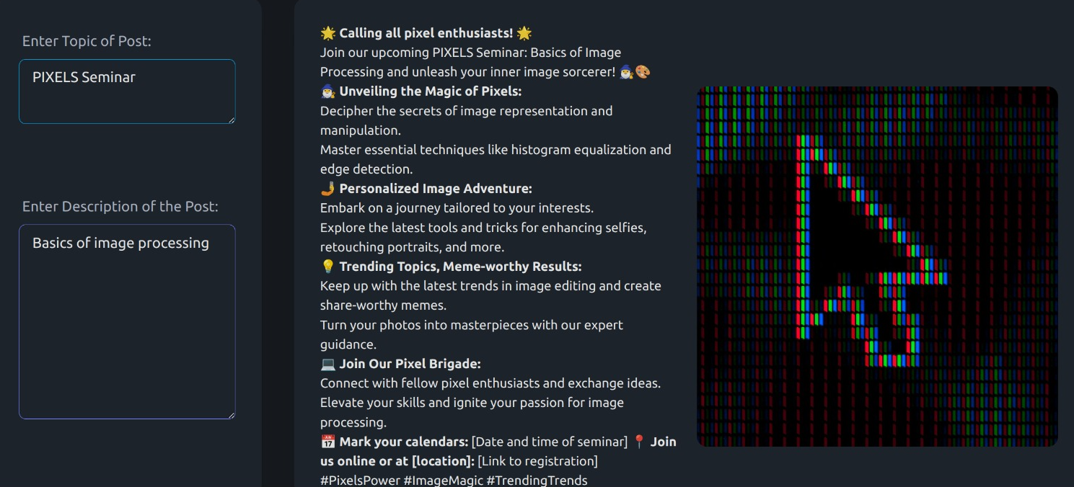
Content Generation
This innovative tool generates eye-catching images and captivating captions.

Slide 7
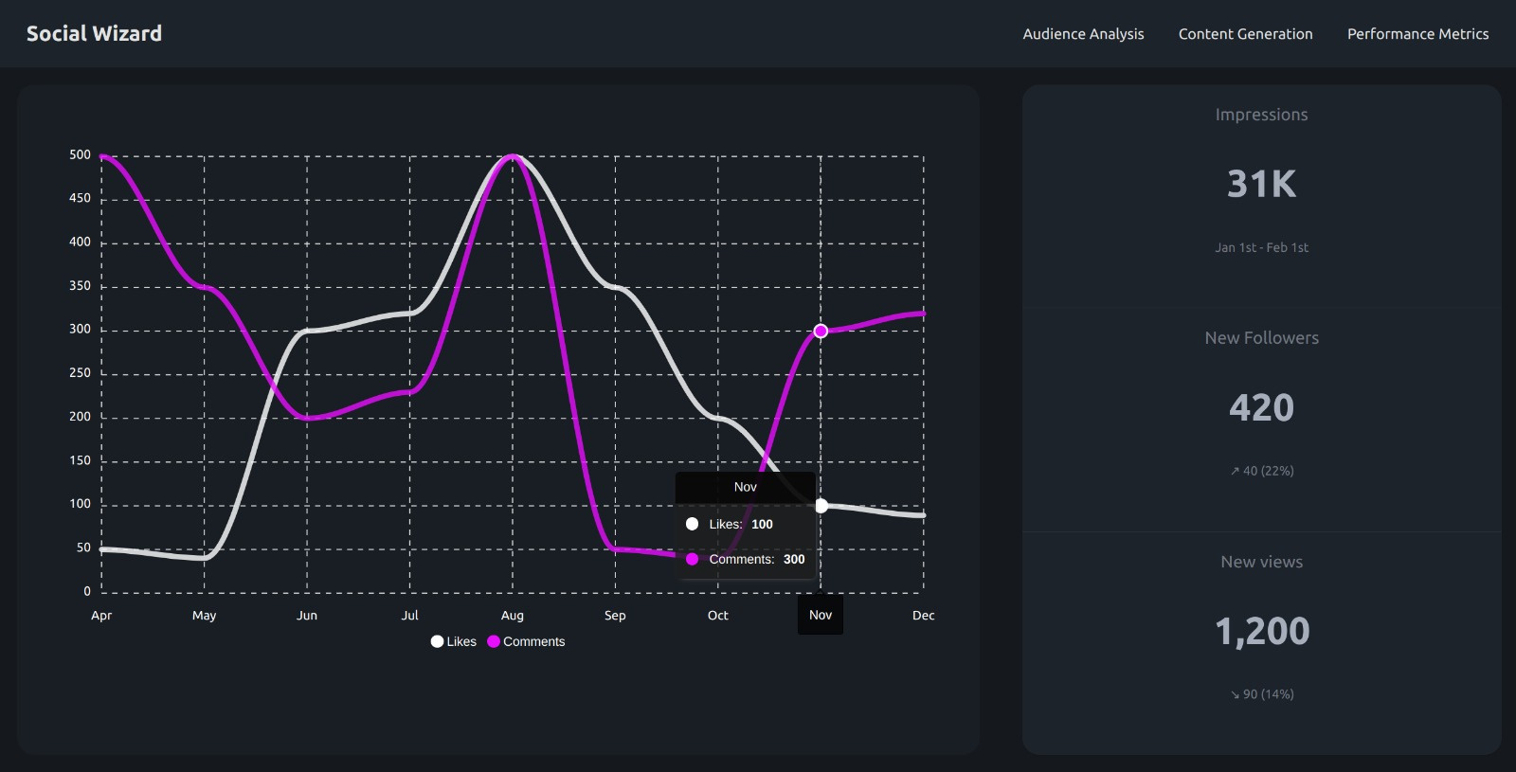
Performance Metrics

Slide 8
Future Scope
Market Analysis:
Analyze the data from various different platforms and showcase the growth in engagement , likes and overall reach.
Optimal posting method:
Using Reinforcement Learning to determine best time for posting content across different platforms.
Auto scheduling:
Building a scheduler which automatically schedules post at different time intervals.

Slide 9
Thank you

